Slide 1


Yanran Chen
Sep 2nd, 2025

Slide 2

Outline
Executive Summary
Introduction
Methodology
Results
Conclusion
Appendix

Slide 3
Executive Summary
This project aims to predict the landing success of SpaceX's Falcon 9 first stage by applying supervised machine learning techniques to historical launch data to identify patterns and key predictors of successful landings.
The dataset was collected from SpaceX REST API, including features such as launch site, payload mass, orbit type, booster version, and flight number, among others. After data cleaning, exploratory data analysis and visualization, four classification models were developed and evaluated: K-Nearest Neighbors (KNN), Support Vector Machines (SVM), Decision Trees, and Logistic Regression. Each model was trained using cross-validation, with hyperparameters tuned for optimal performance. Evaluation metrics included accuracy, precision, recall, and F1-score.
All four models achieved the same accuracy of 83.3% on testing set, demonstrated strong generalization on unseen data. These results suggest that machine learning can be a powerful tool for forecasting rocket landing success, potentially informing future launch strategies and significantly reducing launch costs.

Slide 4
Introduction
SpaceX has revolutionized space transportation by pioneering reusable rocket technology, with the Falcon 9 first stage playing a central role in this innovation. Successful landings of the Falcon 9 booster are essential to reducing launch costs and increasing mission frequency. According to SpaceX, Falcon 9 rocket launches on its website with a cost of $62 million, whereas other providers cost upward of $165 million each. This dramatic cost difference underscores the financial importance of booster recovery. If we can predict whether the first stage will successfully land, we can effectively estimate the cost of a launch and assess mission risk. This project leverages publicly available launch data from the SpaceX REST API to build predictive models that classify whether a Falcon 9 first stage landing will succeed or fail.
The primary objective of this project is to answer the following questions:
Can machine learning models accurately predict the success of Falcon 9 first stage landings based on pre-launch and flight data?
Which features are most influential in determining landing outcomes?
How do different classification algorithms – K-Nearest Neighbors, Support Vector Machines, Decision Trees, and Logistic Regression – compare in terms of predictive performance?
Can these models generalize well to unseen launches, and what are their limitations?

Slide 5

Section 1

Slide 6
Methodology
Executive Summary
Data collection methodology:
Dataset was collected from Space X Rest API and web scraping Wikipedia pages
Perform data wrangling
Identified missing values and imputed missing Payload Mass with its mean value.
Convert landing outcomes into binary classes: Success / Failure
Perform exploratory data analysis (EDA) using visualization and SQL
Perform interactive visual analytics using Folium and Plotly Dash
Perform predictive analysis using classification models
Data was split into training and testing set
Cross validation was used to tune hyperparameters for optimal performance.
Evaluation metrics included accuracy, precision, recall, and F1-score.

Slide 7
Data Collection
Two data collection methods were employed:
1. Launch records were scraped from the SpaceX Wikipedia page by making an HTTP request, parsing the HTML with BeautifulSoup, extracting table headers and row data, and compiling the results into a structured pandas DataFrame.
2. A more robust approach utilized the official SpaceX REST API to retrieve launch data in JSON format. Additional API calls were made to gather detailed information on payloads, cores, and launchpads using their unique IDs in the master JSON
Final datasets from both methods were exported as a CSV files for downstream analysis and model development.

Slide 8
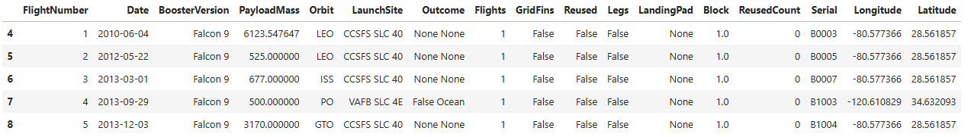
Data Collection – SpaceX API
Make API request to SpaceX API endpoint
Parse the JSON response to Pandas data frame
Make API request to extract additional details for Payloads, core, Launchpad, etc. by their ID
Combine all extracted data into one data frame
Filter the data frame to include only Falcon 9 records
Deal with missing values – Impute missing Payload Mass with its mean value
Export data frame as csv file for future steps
Keep key columns and remove irrelevant records
What the dataset looks like after completing this step
See complete notebook on GitHub: https://github.com/YanranChen/IBM-Data-Science/blob/534e8e398294fa5f8cb53a936c0fab417b336554/C10_Applied_Data_Science_Capstone/M1_Intro/M1Lab1_spacex-data-collection-api.ipynb

Slide 9
Data Collection - Scraping
Make HTTP request to Wiki page
Create BeautifulSoup object from the HTML response
Create a data frame from the columns parsed
Export data frame as csv file for future steps
Extract all column names from the HTML table header
Fill in the parsed launch record values
See complete notebook on GitHub: https://github.com/YanranChen/IBM-Data-Science/blob/534e8e398294fa5f8cb53a936c0fab417b336554/C10_Applied_Data_Science_Capstone/M1_Intro/M1Lab2_webscraping.ipynb

Slide 10
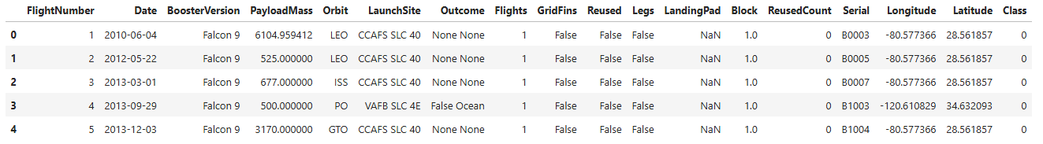
Data Wrangling
Load the data set prepared in the Data Collection step
Calculate the number of occurrence of each value for key categorical columns
Group different Outcomes to create binary Success/Failure label
Export data frame as csv file for future steps
Identify numerical and categorical columns
What the dataset looks like after data wrangling
See complete notebook on GitHub: https://github.com/YanranChen/IBM-Data-Science/blob/c3c5f3f50107e35a4f07db35f470151bff6de88f/C10_Applied_Data_Science_Capstone/M1_Intro/M1Lab3_spacex-data-wrangling.ipynb

Slide 11
EDA with Data Visualization
To uncover patterns and relationships within the SpaceX launch dataset, 6 targeted visualizations were created to address, each addressing a specific analytical question and reveal insights about launch outcomes, payloads, and orbital strategies.
Flight Number vs. Launch Site: A scatter plot was used to examine how launch sites varied across sequential launch attempts (represented by flight number and how this progression correlated with success rates. This helped highlight the technological maturity and reliability trends over time at each location.
Payload Mass vs. Launch Site: A scatter plot explored how payload weight distributions differed by site and whether certain locations were associated with heavier or lighter missions. Overlaying launch outcomes provided insight into how mass and site jointly influenced success.
Success Rate by Orbit Type: A bar chart was used to compare the success rates across different orbital destinations (e.g., LEO, GTO, SSO). This visualization helped identify which orbit types were more reliably reached and which posed greater challenges.
Flight Number vs. Orbit Type: A scatter plot illustrated how the choice of orbit evolved over time, and how it affected success rate.
Payload Mass vs. Orbit Type: A scatter plot examined how payload weight varied across orbit types, helping to assess whether heavier payloads were more likely to be sent to specific orbits and how that impacted success.
Yearly Success Rate Trend: A line plot showed how launch success rates changed year by year, providing a clear view of SpaceX’s operational improvements and reliability growth over time.
Complete notebook for EDA can be found on GitHub: https://github.com/YanranChen/IBM-Data-Science/blob/c3c5f3f50107e35a4f07db35f470151bff6de88f/C10_Applied_Data_Science_Capstone/M2_EDA/M2Lab2_edadataviz.ipynb

Slide 12
EDA with SQL
Additional SQL queries were performed in exploration of the below information:
Names of the unique launch sites in the space mission
The total payload mass carried by boosters launched by NASA (CRS)
Average payload mass carried by booster version F9 v1.1
Date when the first successful landing outcome in ground pad was achieved
Names of the boosters which have success in drone ship and have payload mass between 4000 and 6000
Total number of successful and failure mission outcomes: 61 Success vs 10 Failure
Count of landing outcomes between the date 2010-06-04 and 2017-03-20
Complete notebook for EDA with SQL can be found on GitHub: https://github.com/YanranChen/IBM-Data-Science/blob/c3c5f3f50107e35a4f07db35f470151bff6de88f/C10_Applied_Data_Science_Capstone/M2_EDA/M2Lab2_edadataviz.ipynb

Slide 13
Build an Interactive Map with Folium
Using Python’s Folium library, we created an interactive map to visualize the geographic distribution and performance of SpaceX launch activities. The map includes the following elements:
Initial Center Location: The map is centered on NASA’s Johnson Space Center in Houston, Texas, serving as the starting viewpoint for users.
Launch Site Markers: Each of the 4 SpaceX launch sites is marked with a labeled icon and surrounded by a colored range circle, providing spatial context and allow users to identify key locations at a glance.
Launch Outcome Markers: Individual launch outcomes are represented by colored circles placed at the corresponding launch site – green for successful landings and red for failed attemps. This color-coded system offers an intuitive way to assess performance across sites.
Proximity Analysis: For illustrative purposes, the CCAFS SLC-40 launch site includes straight-line markers connecting it to nearby features such as the coastline, railway, highway, and city. Each line is labeled with its calculated distance, offering insight into logistical and environmental factors.
This visualization offers an intuitive and interactive overview of SpaceX launch activities, highlighting geographic locations and launch outcomes at each site. By combining spatial markers, outcome indicators, and proximity analysis, the map enables users to explore patterns in launch success and site utilization with ease.
Complete notebook for the Interactive Map can be found on GitHub: https://github.com/YanranChen/IBM-Data-Science/blob/94e74e4e8c5d34948c4b50edc6c63ecc8a016671/C10_Applied_Data_Science_Capstone/M3_Interactive_Analytics_and_Dashboards/M3Lab1_launch_site_location.ipynb

Slide 14
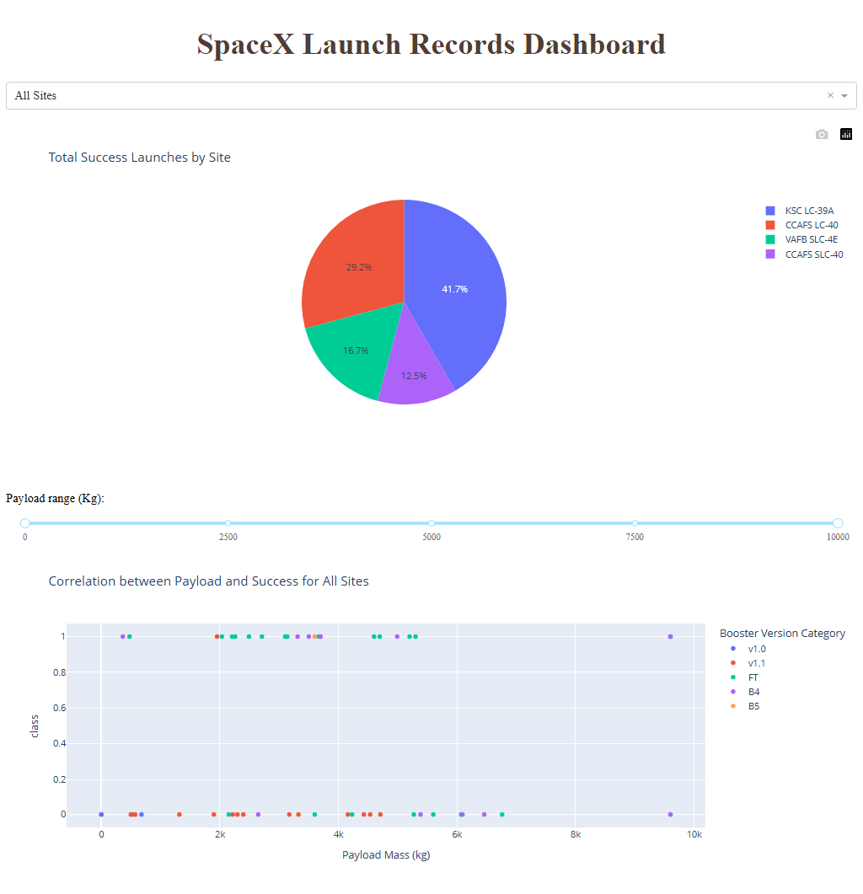
Build a Dashboard with Plotly Dash
To enable real-time interactive exploration of SpaceX launch data, a Plotly Dash application was developed to enable visual analytics through dynamic charts and filters.
This dashboard application contains two input components:
Launch Site Selector: A dropdown menu to choose a specific launch site or view data across all sites
Payload Mass Filter: A range slider to narrow results based on payload weight.
The dashboard features two interactive charts :
Pie chart: Displays the count of successful and failed launches for the selected site. When “All Sites” is selected, it shows the proportion of successful launches across different sites.
Scatter plot: Illustrates the relationship between payload mass and launch outcome, with booster categories represented through color overlays for deeper insight.
Complete code for the Dashboard can be found on GitHub: https://github.com/YanranChen/IBM-Data-Science/blob/e015b4f5550ba765862874772b58cb7bdc1cbdc4/C10_Applied_Data_Science_Capstone/M3_Interactive_Analytics_and_Dashboards/M3Lab2_spacex-dash-app.py

Slide 15




Predictive Analysis (Classification)
Training Set 1~10
(10-fold cross validation)
Model Tuning
Best Model
Training Data
Data
Validation Set 1~10
Model Score
Testing Data
Final Model Evaluation
Complete code for the Dashboard can be found on GitHub: https://github.com/YanranChen/IBM-Data-Science/blob/fc8503bf93ebcfa5b6681a3e4854b595e96db2ff/C10_Applied_Data_Science_Capstone/M4_Predictive_Analysis/M4Lab1_SpaceX_Machine_Learning_Prediction.ipynb

Slide 16
Predictive Analysis (Classification)
Data
Complete code for the Dashboard can be found on GitHub: https://github.com/YanranChen/IBM-Data-Science/blob/fc8503bf93ebcfa5b6681a3e4854b595e96db2ff/C10_Applied_Data_Science_Capstone/M4_Predictive_Analysis/M4Lab1_SpaceX_Machine_Learning_Prediction.ipynb

Slide 17
Predictive Analysis (Classification)
Summarize how you built, evaluated, improved, and found the best performing classification model
You need present your model development process using key phrases and flowchart
Complete code for the Dashboard can be found on GitHub: https://github.com/YanranChen/IBM-Data-Science/blob/fc8503bf93ebcfa5b6681a3e4854b595e96db2ff/C10_Applied_Data_Science_Capstone/M4_Predictive_Analysis/M4Lab1_SpaceX_Machine_Learning_Prediction.ipynb

Slide 18
Results
Exploratory data analysis results
Interactive analytics demo in screenshots
Predictive analysis results

Slide 19

Section 2

Slide 20
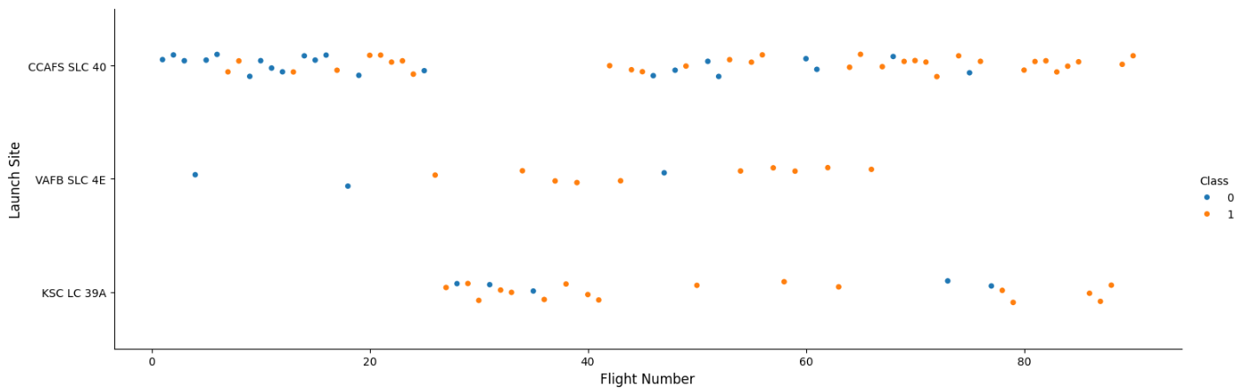
Flight Number vs. Launch Site
Observations:
Early launches were almost all from CCAFS SLC‑40 and had low success rates.
Success rates improved with higher flight numbers, likely reflecting technological maturity over time.
Similar patterns appeared at the other two launch sites, suggesting that launch site location is not a major driver of landing success.

Slide 21
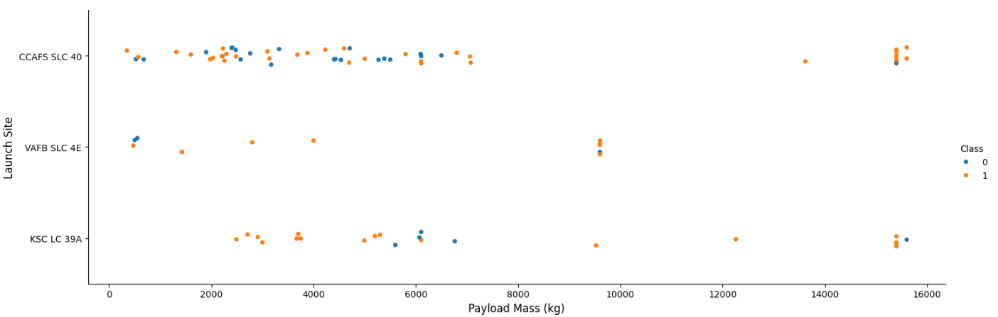
Payload vs. Launch Site
Observations:
Heaviest payload masses were mostly launched at CCAFS SLC-40 and KSC LC-39A sites
VAFB-SLC launch site was frequently used when payload mass was right below 10,000kg but never used when payload mass is beyond 10,000kg.

Slide 22
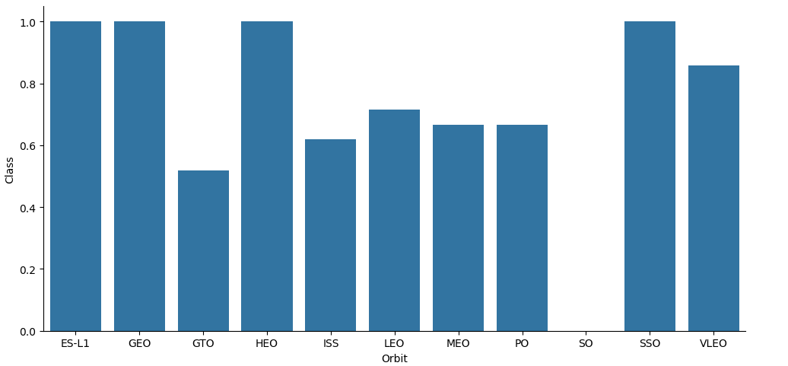
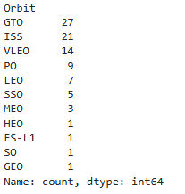
Success Rate vs. Orbit Type
# Launches of each orbit
Observations:
1. Exclude orbits that had only 1 launch, SSO (5 launches) has the highest success rate (100%), VLEO (14 launches) also has relatively good success rate ( above 80%)
*Note: GTO is a transfer orbit and not itself geostationary.

Slide 23
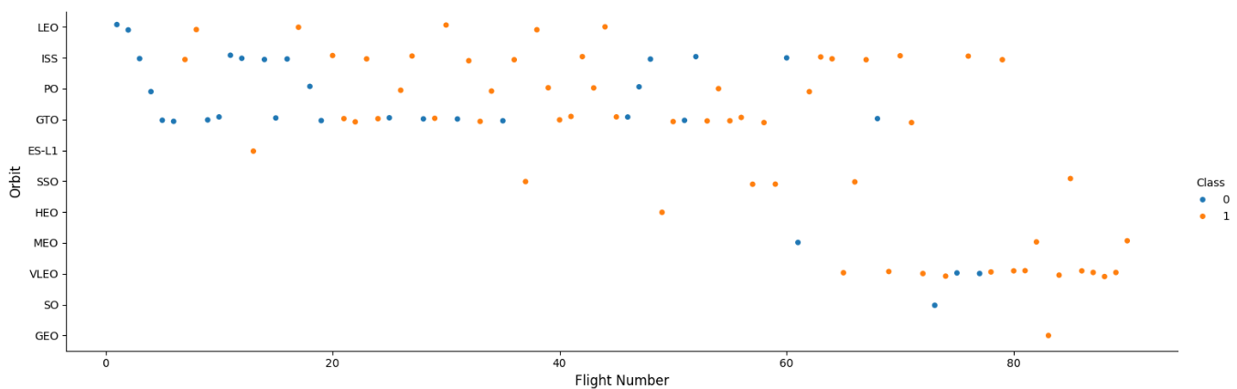
Flight Number vs. Orbit Type
Observations:
In the LEO orbit, success seems to be related to the number of flights
VLEO orbit was frequently used for later launches (Flight Number >60), which, when combined with the previous observation of its high success rate, still indicate the maturity of the program seem to be a major driver.

Slide 24
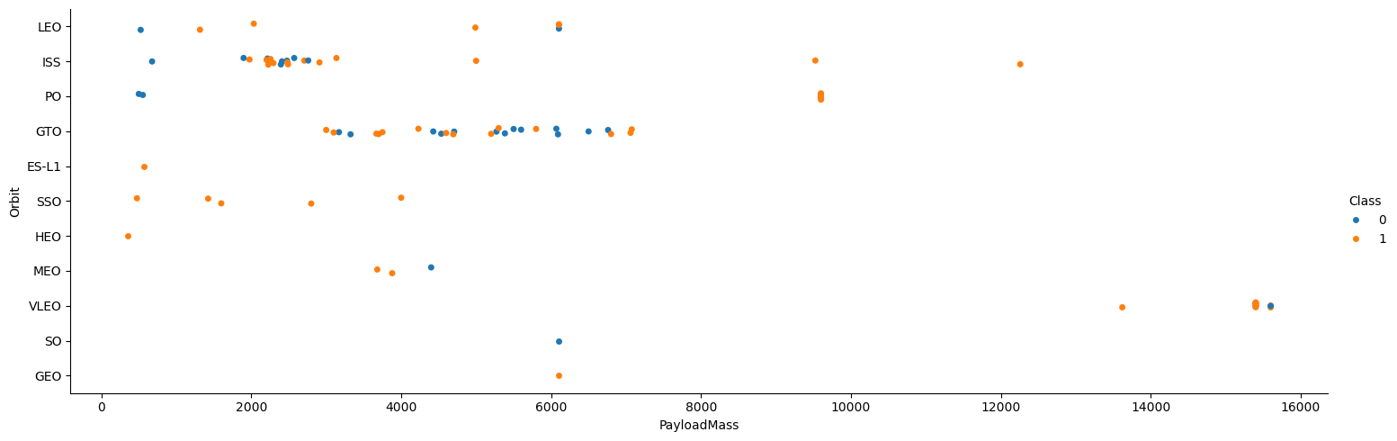
Payload vs. Orbit Type
Observations:
With heavy payloads the successful landing or positive landing rate are more for PO and ISS.
SSO had 100% success rate with light payloads.

Slide 25
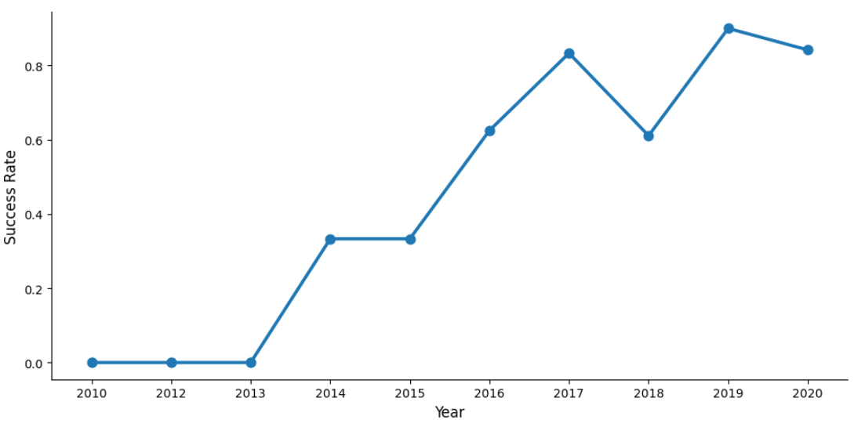
Launch Success Yearly Trend
Observation:
As it has been repeated observed that Flight Number seems to be the biggest factor for success rate, our final chart here explores the success rate yearly trend. And we can see that success rate kept improving since 2013 through 2017, with a slight dip in 2018, and rebounded in 2019.

Slide 26
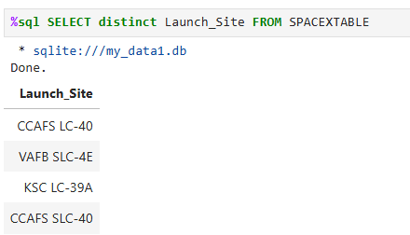
All Launch Site Names
4 unique launch sites can be found in this dataset: CCAFS LC-40, CCAFS SLC-40, VAFB SLC-4E, KSC LC-39A

Slide 27
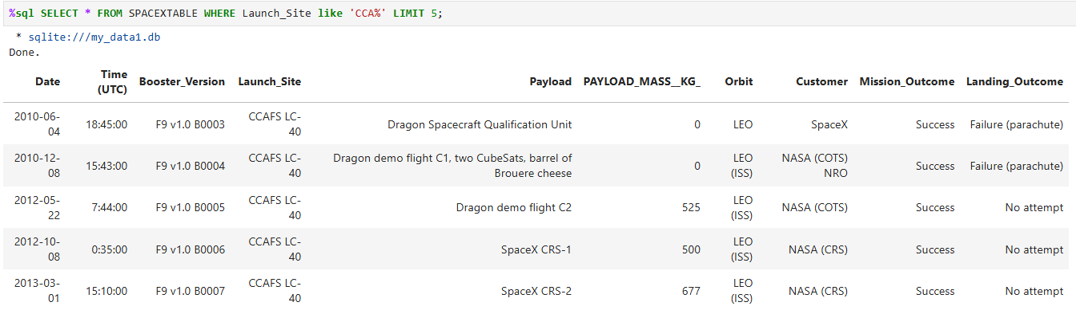
Launch Site Names Begin with 'CCA'
Below is 5 records where launch sites begin with the string 'CCA'

Slide 28
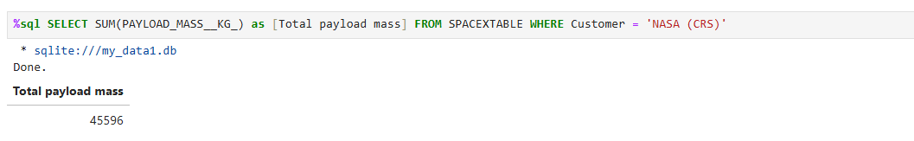
Total Payload Mass
The total payload mass carried by boosters launched by NASA (CRS): 45,596 KG

Slide 29
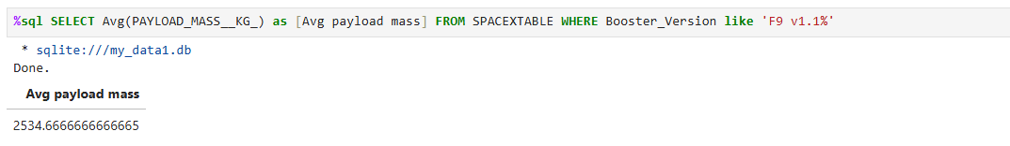
Average Payload Mass by F9 v1.1
Average payload mass carried by booster version F9 v1.1: 25,34.67 KG

Slide 30
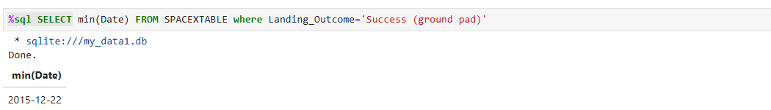
First Successful Ground Landing Date
Date when the first successful landing outcome in ground pad was achieved: 2015-12-22

Slide 31
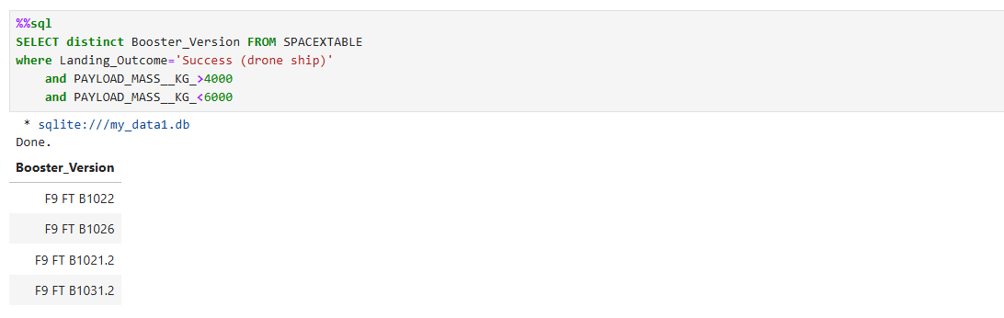
Successful Drone Ship Landing with Payload between 4000 and 6000
Four boosters had success in drone ship and have payload mass between 4000 and 6000, they are: F9 FT B1022, F9 FT B1026, F9 FT B1021.2, F9 FT B1031.2

Slide 32
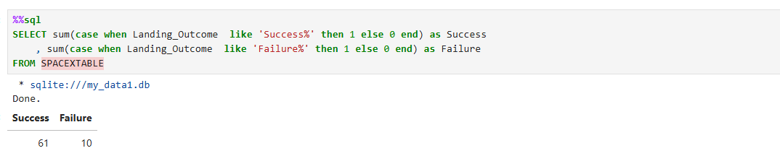
Total Number of Successful and Failure Mission Outcomes
Among all mission outcomes, there are 61 Success and 10 Failure

Slide 33
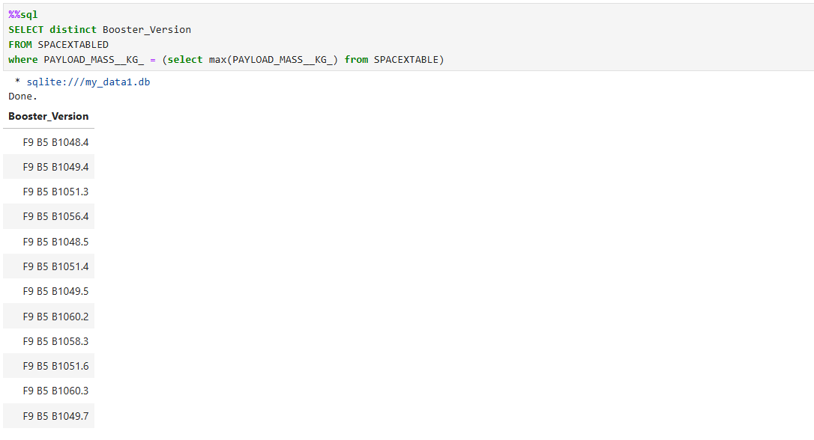
Boosters Carried Maximum Payload
Below is a list of all the booster_versions that have carried the maximum payload mass

Slide 34
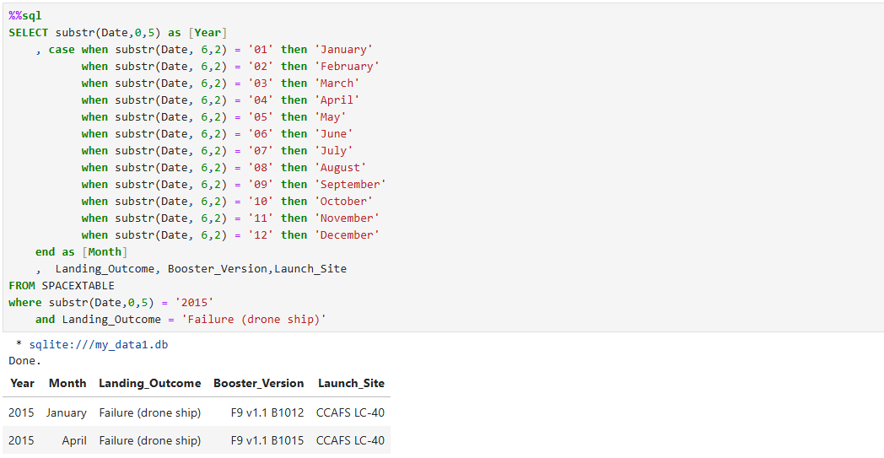
2015 Launch Records
There are two failed drone shop landing in year 2015, below table shows their booster version, launch_site.

Slide 35
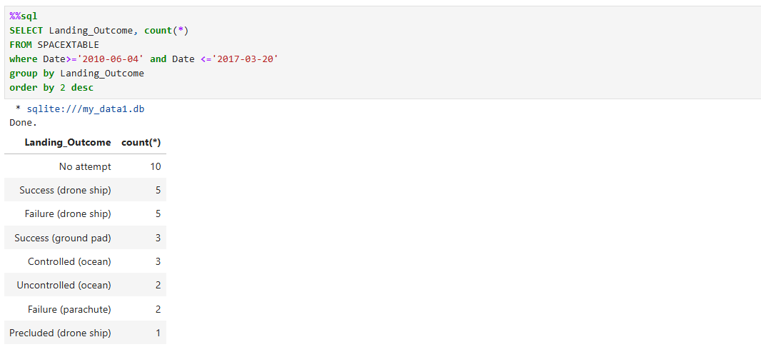
Rank Landing Outcomes Between 2010-06-04 and 2017-03-20
Below is the count of landing outcomes between the date 2010-06-04 and 2017-03-20, ranked in descending order.

Slide 36

Section 3

Slide 37
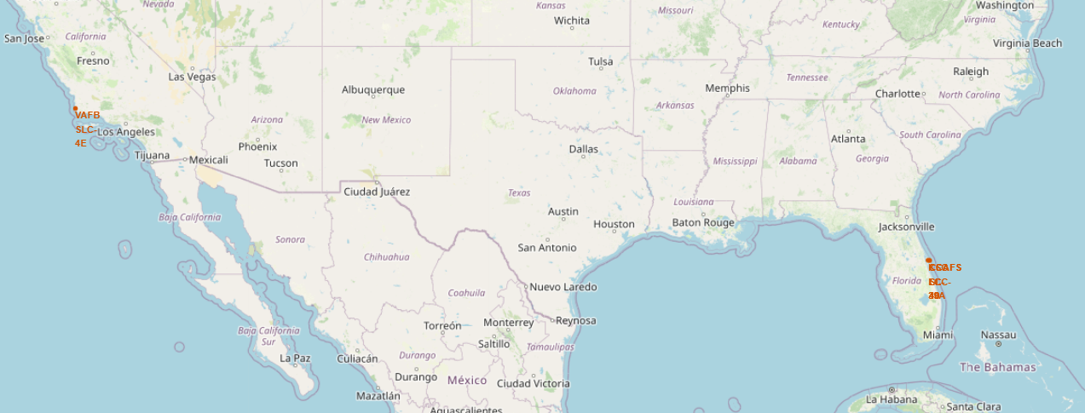
SpaceX Launch Site Locations
Key Insights:
All SpaceX launch sites are strategically located near the Equator, optimizing fuel efficiency and orbital mechanics for missions.
Each site is situated in close proximity to the coastline, which provides a safe trajectory over open water and facilitates logistical access for recovery operations.

Slide 38
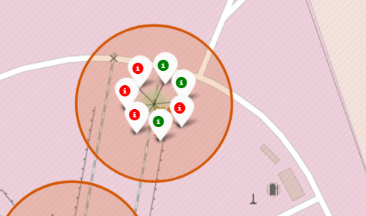
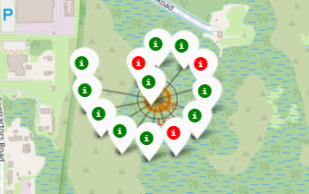
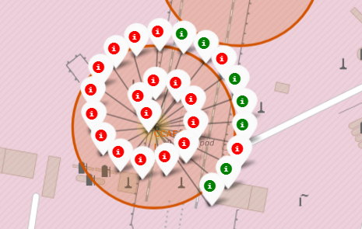
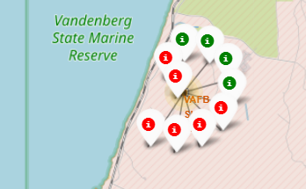
Launch Outcomes for Each Site
Key Insights:
Mapping SpaceX launch outcomes reveals a clear performance distinction between sites:
KSC LC-39A stands out with the highest success rate, underscoring its reliability for critical missions.
In contrast, CCAFS LC-40, while hosting the highest number of launches, shows a comparatively lower success rate.
This suggests that LC-40 may be used for higher-frequency, lower-risk missions, while LC-39A is reserved for high-stakes operations requiring proven dependability.
Launch Site CCAFS SLC-40
Launch Site KSC LC-39A
Launch Site CCAFS LC-40
Launch Site VAFB SLC-4E

Slide 39
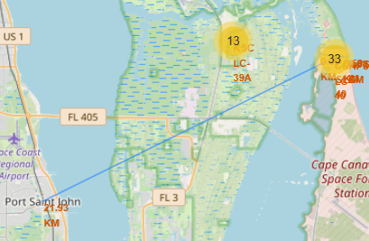
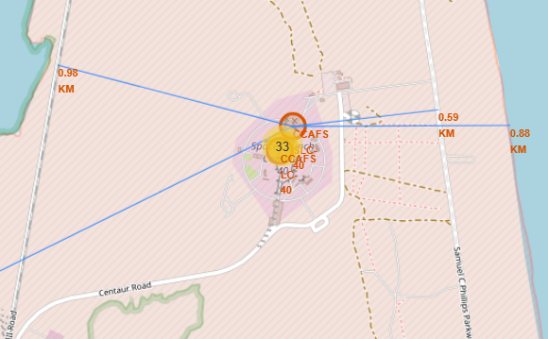
Proximities of Launch Sites
Key Insights:
All launch sites are strategically located within close proximity – typically less than 1km – to railways, highways, and coastlines, facilitating logistical efficiency and safety. However, they are deliberately situated at a greater distance from populated cities to mitigate risk and minimize disruption.
The screenshots below illustrated the proximities of the CCAFS SLC-40 launch site. It is located within 1 km of the nearest railway, highway, and coastline, while roughly 22 km away from the closest city.

Slide 40

Section 4

Slide 41
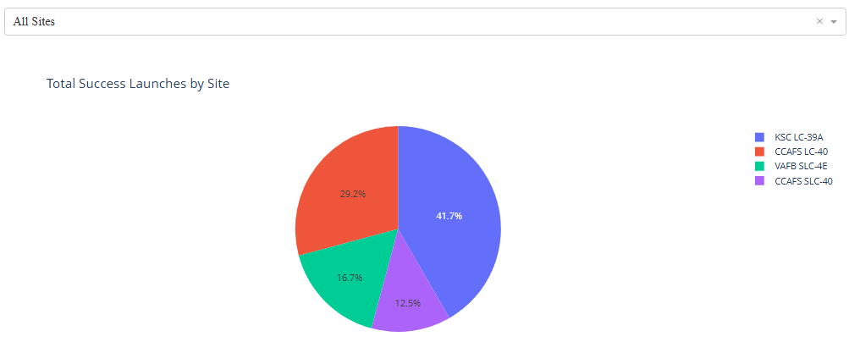
Share of Success Launches by Site
Key Insights: Launch Site KSC LC-39A leads in successful missions, contributing 41.7% of all SpaceX launch successes. This highlights its role as the most productive launch site in the dataset.

Slide 42
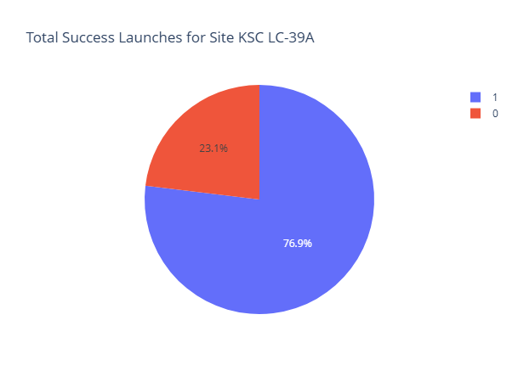
Launch Site with Highest Success Rate
Key Insights:
Launch Site KSC LC-39A not only leads in total successful launches but also boasts the highest launch success rate at 77%. This underscores its operational reliability and strategic importance within SpaceX’s launch infrastructure. CCAFS LC-40 follows closely with a 73% success rate.

Slide 43
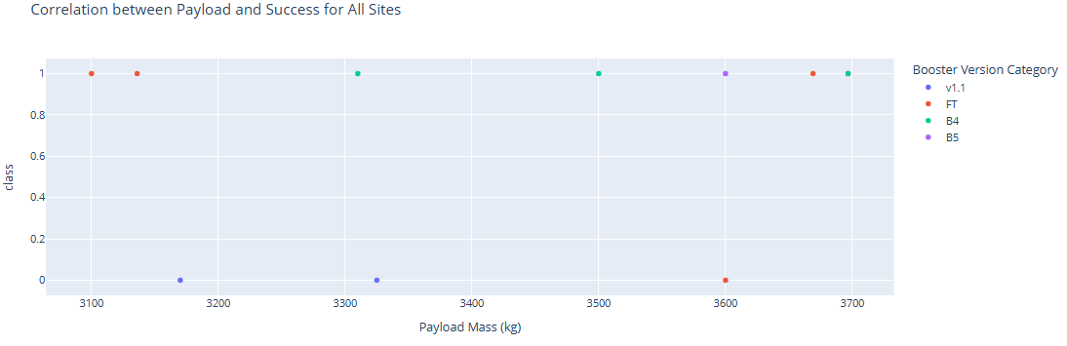
Payload Range with the Highest Success Rate
Key Insight:
Launches with payloads between 3,000 kg and 4,000 kg achieved the highest success rate at 73% across 11 missions
Note: some launches within this payload range share identical payload masses, causing overlapping data points on the chart.

Slide 44
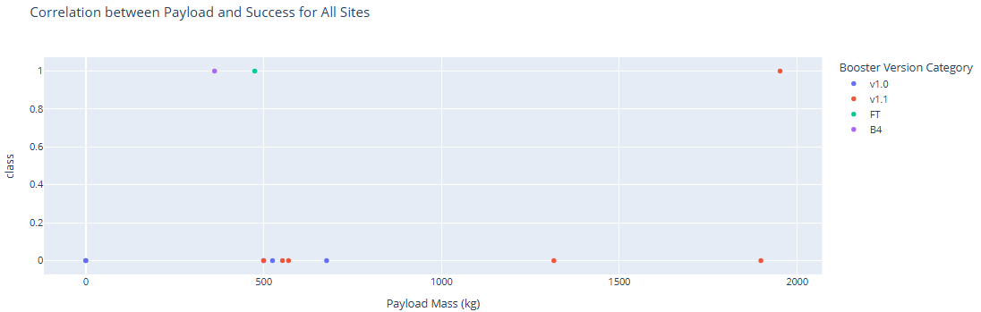
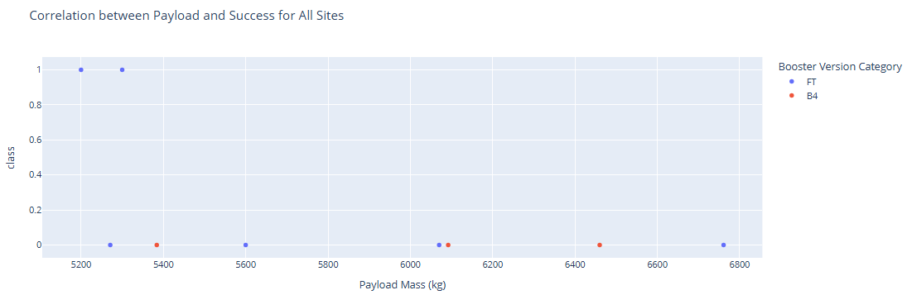
Payload Ranges with the Lowest Success Rates
Key Insights:
Launches carrying payloads between 0 kg and 2,000 kg exhibited a low success rate of just 23% across 13 missions, suggesting potential challenges with lighter payload configurations.
The 5,000 kg to 7,000 kg range saw 2 successful launches out of 9 attempts, a success rate of 22%.

Slide 45
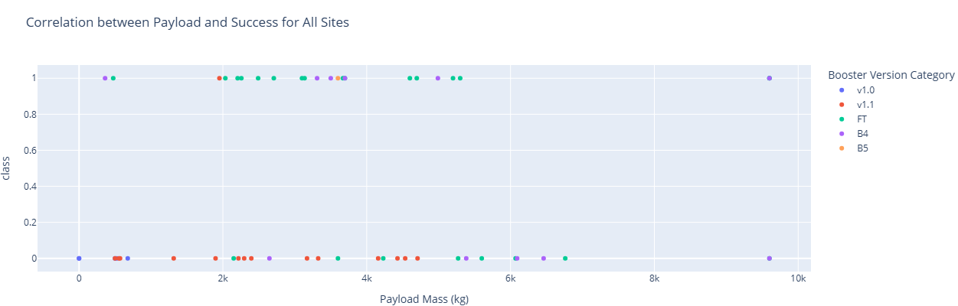
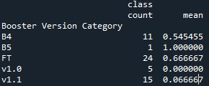
Success Rates by Booster
Key Insight:
FT appears to be the most reliable and frequently used booster, with a solid 66.7% success rate across 24 launches.
B5 shows perfect performance, but with only one launch, it’s too early to draw conclusions.
B4 has moderate reliability at 54.5% over 11 launches.
Meanwhile, v1.0 and v1.1 stand out as underperformers, with extremely low success rates (0.0% and 6.7%, respectively), suggesting they may need redesign or retirement. Overall, FT seems the strongest candidate for continued use and improvement.

Slide 46

Section 5

Slide 47
Classification Accuracy
Visualize the built model accuracy for all built classification models, in a bar chart
Find which model has the highest classification accuracy

Slide 48
Confusion Matrix
Show the confusion matrix of the best performing model with an explanation

Slide 49
Conclusions
Point 1
Point 2
Point 3
Point 4
…

Slide 50
Appendix
Include any relevant assets like Python code snippets, SQL queries, charts, Notebook outputs, or data sets that you may have created during this project

Slide 51


